Slide 1
LIBRARY MANAGEMENT
SYSTEM
CB.EN.P2EBS22002
N.SUBA RENJANI

Slide 2
Objective
The Library Management System In Python is a simple project developed using Python. The project contains only the admin side. The admin side does all the management like adding and managing categories, authors, books, issued books, and so on. Thus, this is a digital way of management of the library system.
The project file contains a python script (Main.py, Borrow.py, Return.py, dt.py, ListSplit.py) and a text file(stock.txt). Also, this project makes it easy for the library to keep the records of books, borrowing and returning of books in a digital way.

Slide 3
Features
Borrow
Datetime
List split
Return
Transaction

Slide 4
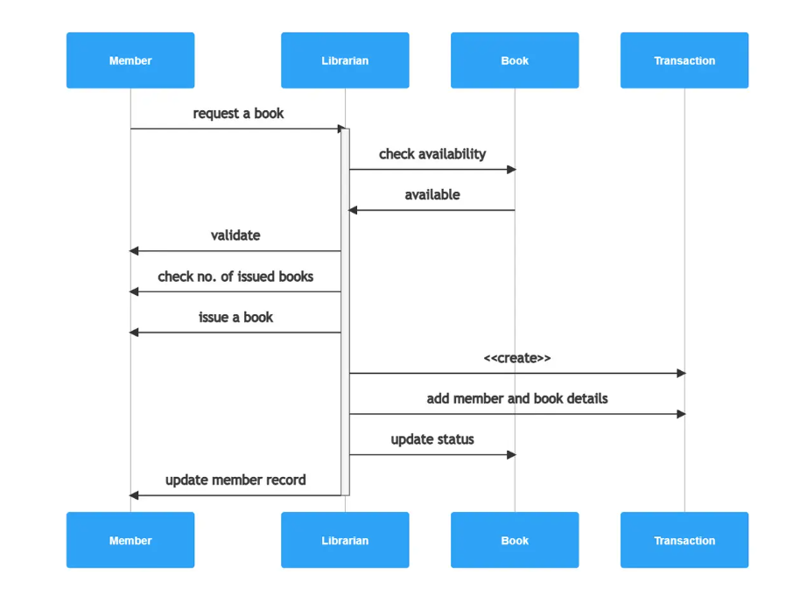
BLOCK DIAGRAM

Slide 5
reference
https://itsourcecode.com/free-projects/php-project/library-management-system-php-source-code/

